Slide 1
6:3-21

Slide 2
6:3-21
1 Timothy 6:3–21 ~ ³ If anyone teaches otherwise and does not consent to wholesome words, even the words of our Lord Jesus Christ, and to the doctrine which accords with godliness, ⁴ he is proud, knowing nothing, but is obsessed with disputes and arguments over words, from which come envy, strife, reviling, evil suspicions, ⁵ useless wranglings of men of corrupt minds and destitute of the truth, who suppose that godliness is a means of gain. From such withdraw yourself.
⁶ Now godliness with contentment is great
gain. ⁷ For we brought nothing into this world, and it is certain we can carry nothing out.

Slide 3
6:3-21
1 Timothy 6:3–21 ~ ⁸ And having food and clothing, with these we shall be content. ⁹ But those who desire to be rich fall into temptation and a snare, and into many foolish and harmful lusts which drown men in destruction and perdition. ¹⁰ For the love of money is a root of all kinds of evil, for which some have strayed from the faith in their greediness, and pierced themselves through with many sorrows.
¹¹ But you, O man of God, flee these things and
pursue righteousness, godliness, faith, love, patience, gentleness. ¹² Fight the good fight of faith,
lay hold on eternal life,

Slide 4
6:3-21
1 Timothy 6:3–21 ~ to which you were also called and have confessed the good confession in the presence of many witnesses. ¹³ I urge you in the sight of God who gives life to all things, and before Christ Jesus who witnessed the good confession before Pontius Pilate, ¹⁴ that you keep this commandment without spot, blameless until our Lord Jesus Christ’s appearing, ¹⁵ which He will manifest in His own time, He who is the blessed and only Potentate, the King of kings and Lord of lords, ¹⁶ who alone has immortality, dwelling in unapproachable light, whom no man has seen
or can see,

Slide 5
6:3-21
1 Timothy 6:3–21 ~ to whom be honor and everlasting power. Amen.
¹⁷ Command those who are rich in this present age not to be haughty, nor to trust in uncertain riches but in the living God, who gives us richly all things to enjoy. ¹⁸ Let them do good, that they be rich in good works, ready to give, willing to share, ¹⁹ storing up for themselves a good foundation for the time to come, that they may lay hold on eternal life.
²⁰ O Timothy! Guard what was committed to your trust, avoiding the profane and idle babblings and contradictions of what is falsely

Slide 6
6:3-21
1 Timothy 6:3–21 ~ called knowledge — ²¹ by professing it some have strayed concerning the faith.
Grace be with you. Amen.

Slide 7
6:3-21

Slide 8
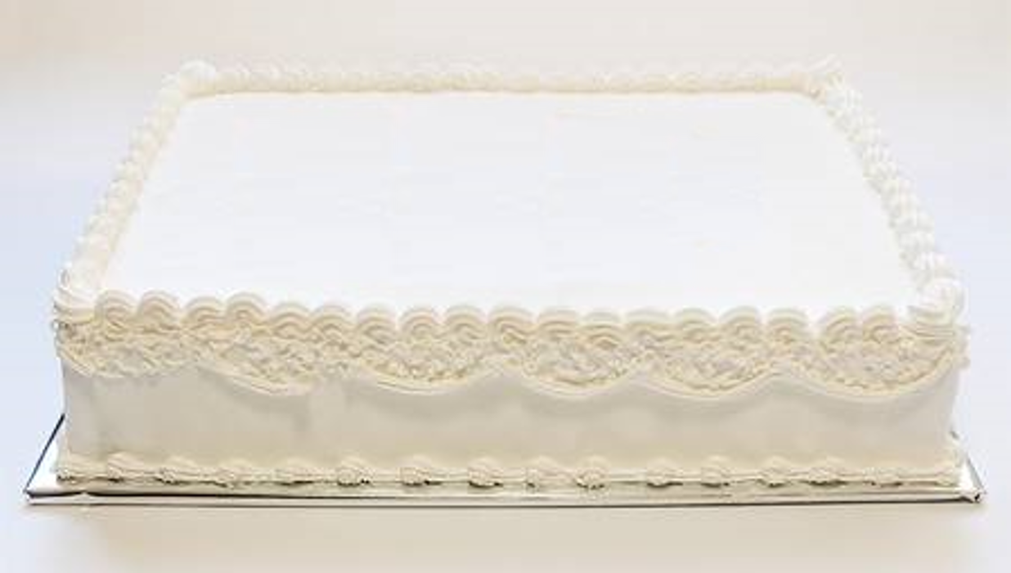
6:3-21
1
John 4:18
“There is no fear
in love, but perfect love casts out fear.”
“for you have had five husbands, and the man you have now is
not your husband.”

Slide 9
6:3-21

Slide 10
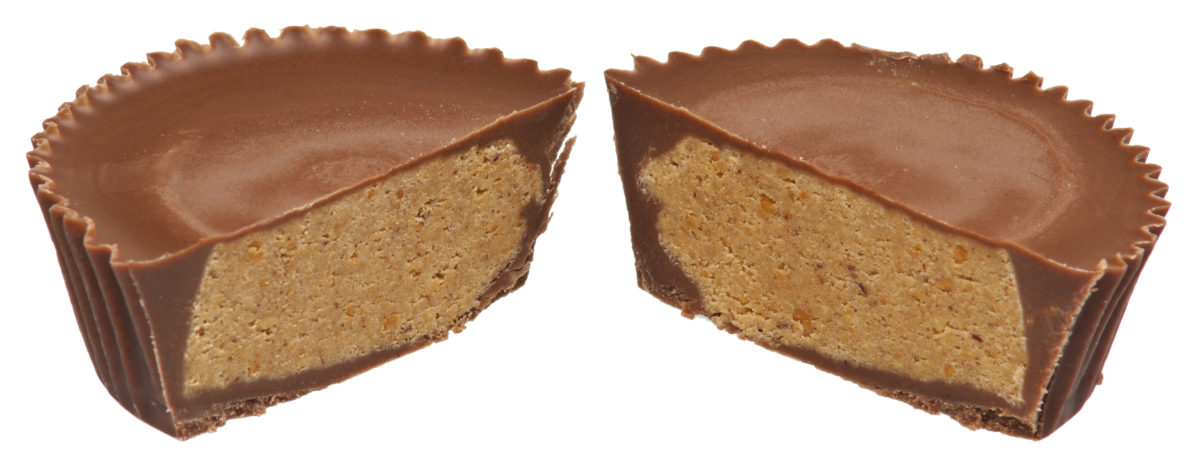
6:3-21
doctrine
doctrine
godliness
godliness
This Photo by Unknown Author is licensed under CC BY

Slide 11
6:3-21
Phil. 1:15-18 ~ ¹⁵ Some indeed preach Christ even from envy and strife, and some also from good will: ¹⁶ The former preach Christ from selfish ambition, not sincerely, supposing to add affliction to my chains; ¹⁷ but the latter out of love, knowing that I am appointed for the defense of the gospel. ¹⁸ What then? Only that in every way, whether in pretense or in truth, Christ is preached; and in this I rejoice, yes, and will rejoice.

Slide 12
6:3-21
Titus 3:10-11 ~ ¹⁰ Reject a divisive man (hairetikos) after the first and second admonition, ¹¹ knowing that such a person is warped and sinning, being self-condemned.

Slide 13
6:3-21

Slide 14
6:3-21
godliness ~ 9 of 16x in New Testament (NKJV) in 1 Timothy
“godliness” without contentment is legalism
“godliness” without contentment is legalism
“contentment” without godliness is denial

Slide 15
6:3-21
more than some
some
more than most
very little
lots
Materialism
hardly any
oodles
stuff-o-meter

Slide 16
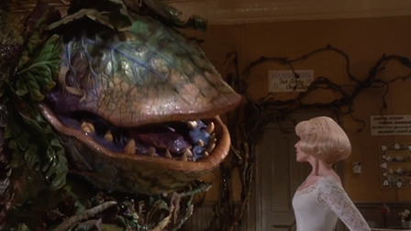
6:3-21
Feed me!
Audrey II, The Little Shop of Horrors

Slide 17
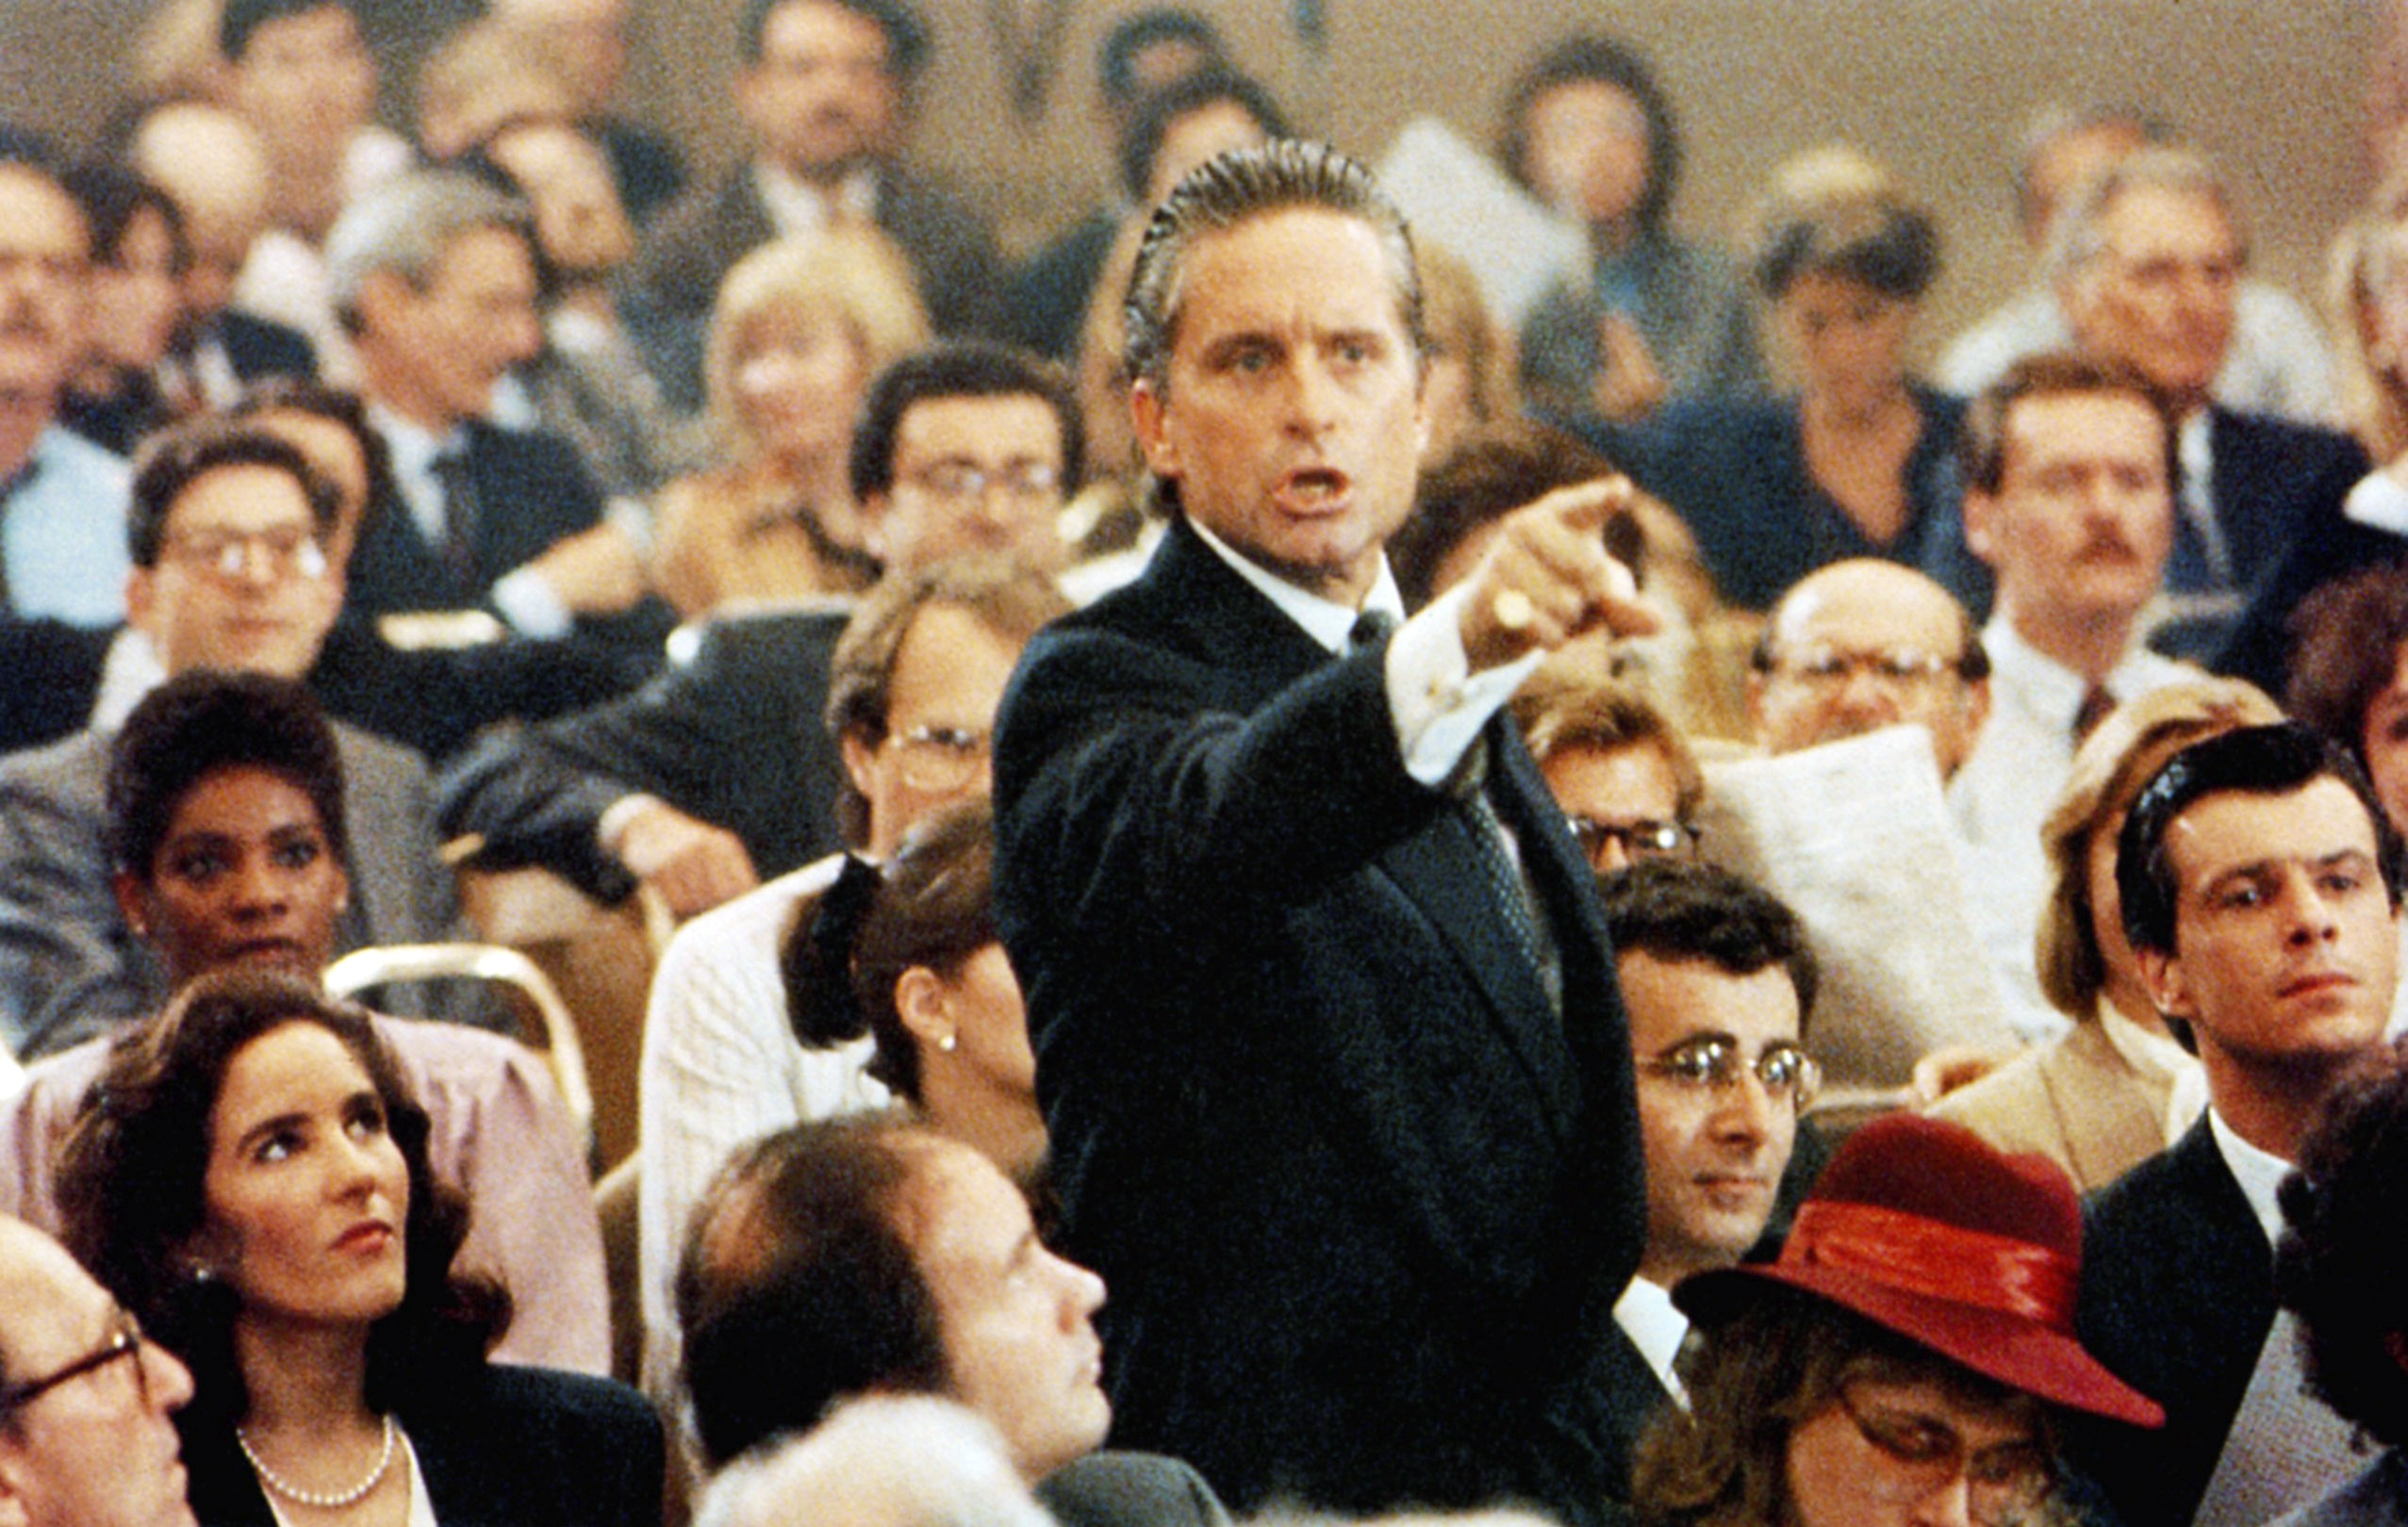
6:3-21
Greed is good!
Gordon Gekko, Wall Street

Slide 18
6:3-21

Slide 19
6:3-21
Phil. 4:11 ~ Not that I speak in regard to need, for I have learned in whatever state I am, to be content:

Slide 20
6:3-21

Slide 21
6:3-21
flee
follow
Fight
pursue, KJV – follow after ~ diokō (31 of 44x in KJV translated persecute)
agōnizomai

Slide 22
6:3-21

Slide 23
6:3-21
immortality ~ athanasia – without death

Slide 24
6:3-21

